Slide 1
Self-Organising Maps
Huafu Chen
Neural Networks, Simon Haykin, Prentice-Hall, 2nd edition

Slide 2
Unsupervised Learning
Neural networks for unsupervised learning attempt to discover special patterns from available data without using external help (i.e. RISK FUNCTION).
  There is no information about the desired class (or output ) d of an example x. So only x is given.
  Self Organising Maps (SOM) are neural network models for unsupervised learning, which combine a competitive learning principle with a topological structuring of neurons such that adjacent neurons tend to have similar weight vectors.

Slide 3
SOM: Biological Motivation
Neurobiological hypothesis:
  The structure self-organises based on learning rules and system interaction.
  Axons physically maintain neighborhood relationships as they grow.

Slide 4
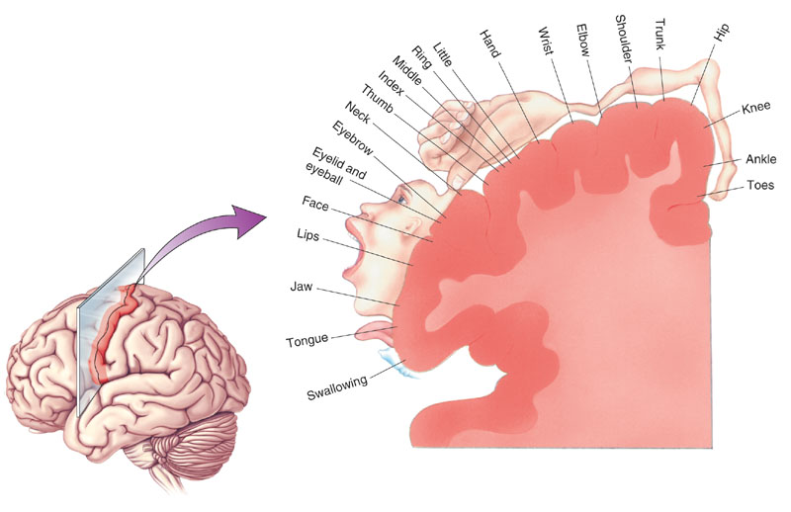
Topographic maps
  Somatotopic map: projection of body surface onto a brain area, called somatosensory cortex, responsible for sense of touch.
  Motor map: Is similar for movement commands instead of touch.
  Retinotopic map: Is for vision. The area is called superior colliculus（上丘）.
  Phonotopic map: Is for hearing: the auditory cortex.
Notes:
Somatotopic organization 躯体定位组织
Motor map

Slide 5
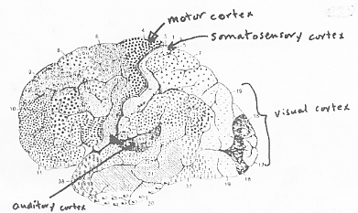
The cytoarchitectural map

Slide 6
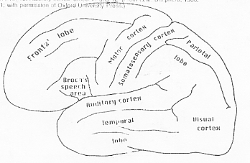
The cytoarchitectural map

Slide 7
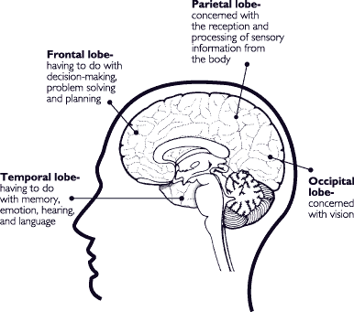
Cerebral
Cortex
http://www.health.org/pubs/qdocs/mom/TG/intro.htm

Slide 8
Feature-mapping models
Principle of topographic map (TM) formation
spatial location of output neuron in a TM corresponds to a domain or feature of data drawn from input space

Slide 9
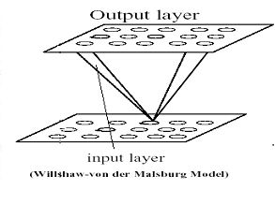
Two self-organised maps
Willshaw-von der Malsburg Model
  two 2D lattices : one for input neurons, others for output neurons
  Hebbian type modifiable synapses
  Postsynaptic lattice：short-range : excitatory；long-range : inhibitory
  geometric proximity of pre-synaptic neurons is coded in the form of correlation, and it is used in postsynaptic lattice
  specialized for mapping for same dimension of input and output
Notes:
this model grounds to explain the problem of retinotopic mapping from the retina to the visual cortex ( in higher vertebrates)

Slide 10
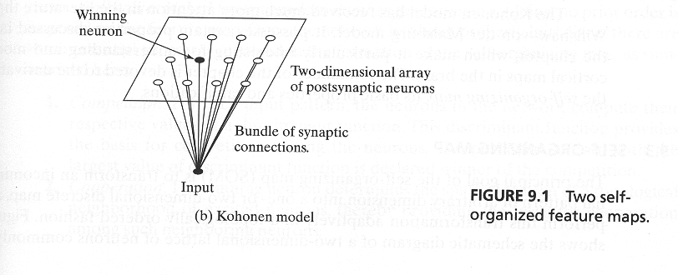
Kohonen Model
Captures essential features of computational maps in Brain
More general and more attention than Willshaw-Malsburg model
  capable of dimensionality reduction
Belong to vector coding algorithm
  optimally map into fixed number of code words
Notes:
在Kohonen结构中，输入是一 个矢量，可以说是一个一维结构，而输出层 则可以是一/二或多维结构
这一点不同与Willshaw-Malsburg模型，那里输入与输出的结构严格对应

Slide 11
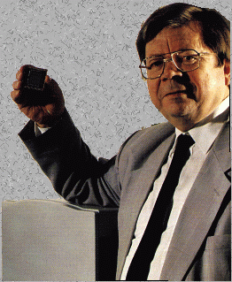
Teuvo Kohonen
http://www.cis.hut.fi/research/som-research/teuvo.html

Slide 12


Slide 13
ARCHITECTURE
The input is connected with each neuron of a lattice.
Lattice Topology: It determines a neighbourhood structure of the neurons.
1-dimensional topology
A small neighbourhood
2-dimensional topology
Two possible neighbourhoods
Notes:
在人脑中存在3维结构，如视觉皮层，6层生神经元的立体交叉结构

Slide 14
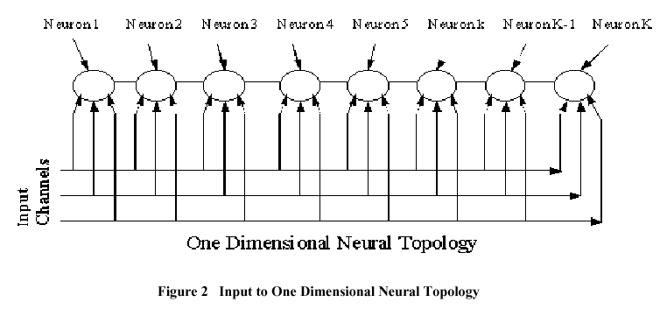
One-dimensional lattice
－维
Notes:
输入是一个三维vector

Slide 15
Two-dimensional lattice
Layer
of
source
nodes
Notes:
输入是一个三维vector

Slide 16
The goal
to find values of weight vectors
from the input layer to the lattice nodes
in such a way that adjacent neurons （output layer) will have similar weight vectors --- cooperation

Slide 17
The goal
For an input,
the output of the NN will be the neuron
whose weight vector is most similar to that input

Slide 18
The goal
In this way,
each (weight vector of a) neuron is the center of a cluster
containing all the input examples which are mapped to that neuron.

Slide 19
The learning process
Simple description:
Given: an input pattern (vector) x
Find: the neuron i which has closest weight vector by competition (inner product w_{i}^{T} x will be the highest).
For each neuron j in the neighbourhood N(i) of the winning neuron i:
  update the weight vector of j.
  Neurons which are not in the neighbourhood are left unchanged.
Notes:
一开始是随机的，反映小孩早期教育的重要性

Slide 20
The learning process
The SOM algorithm:
  Starts with large neighbourhood size and gradually reduces it.
  Gradually reduces the learning rate η.

Slide 21
The learning process
  Upon repeated presentations of the training examples,
  the weight vectors tend to follow the distribution of the examples.
  This results in a topological ordering of the neurons,
  where neurons adjacent to each other tend to have similar weights.

Slide 22
The learning process
There are basically three essential processes:
  competition
  cooperation
  weight adaption

Slide 23
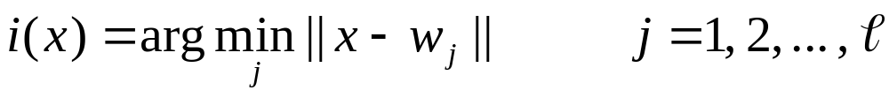
The learning process
Competition:
  Competitive process: Find the best match of input vector x with weight vectors:
  The input space of patterns is mapped onto a discrete output space of neurons by a process of competition among the neurons of the network.
total number
of neurons
winning neuron
Notes:
这里用距离，NN中的WX点乘积 也是反映W 与X 的距离（相似性），尤其在W如果都是归一化的量的时候
比较距离的过程 就是competition process

Slide 24
The learning process
Cooperation:
  Cooperative process: The winning neuron locates at the center of a topological neighbourhood of cooperating neurons.
  The topological neighbourhood depends on lateral distance d_{ji} between the winner neuron i and neuron j.

Slide 25
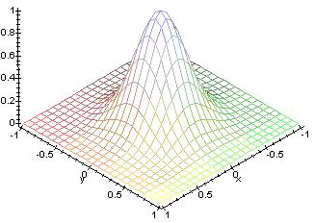
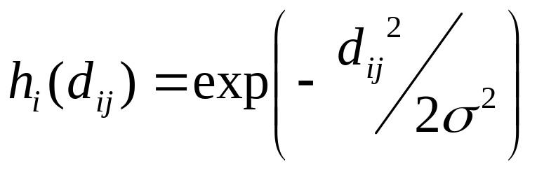
Learning Process
- neighbourhood function
  Gaussian neighbourhood function
h_{i}
1.0
2σ
0
d_{ji}

Slide 26
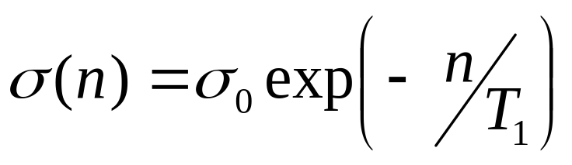
Learning process
  σ (effective width) measures degree to which excited neurons in the vicinity of the winning neuron participate to the learning process.
  d_{ji}: lateral distance
    in one dimension lattice || j – i ||
    in two dimension lattice || r_{j} - r_{i} || r_{j} is the position of neuron j in the lattice.
exponential decay update
time constant
Notes:
The n=0,1,2,. The progress of the iteration.

Slide 27
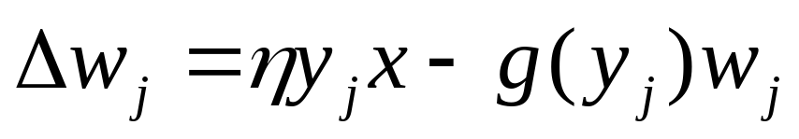
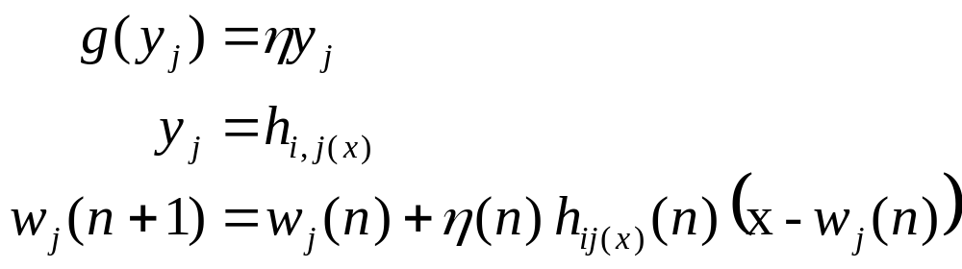
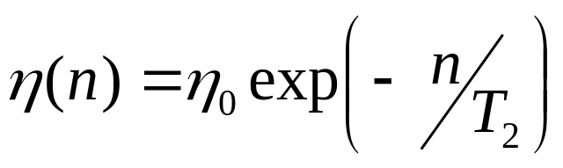
Learning process
Applied to all neurons inside the neighbourhood of the winning neuron i.
Hebbian term
forgetting term
scalar function of response y_{j}
exponential decay update:

Slide 28
Two phases of weight adaption
Self organising or ordering phase:
  Topological ordering of weight vectors.
  May take 1000 or more iterations of SOM algorithm.
Important choice of parameter values:
  η(n): η ₀ = 0.1 T₂ = 1000 ⇒ decrease gradually η(n) ≥ 0.01
  h_{ji(x)}(n): σ ₀ big enough T₁ =
  Initially the neighbourhood of the winning neuron includes almost all neurons in the network, then it shrinks slowly with time.
1000
log (σ₀)

Slide 29
Two phases of weight adaption
Convergence phase:
  Fine tune feature map.
  Must be at least 500 times the number of neurons in the network ⇒ thousands or tens of thousands of iterations.
Choice of parameter values:
  η(n) maintained on the order of 0.01.
  h_{ji(x)}(n) contains only the nearest neighbours of the winning neuron. It eventually reduces to one or zero neighbouring neurons.

Slide 30
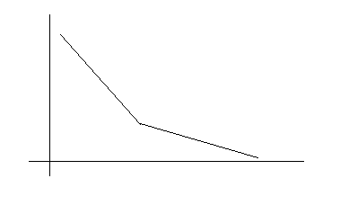
Adaptive Process
Ordering
Convergence

Slide 31
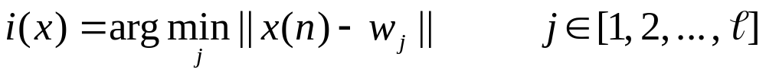
A summary of SOM
Initialization: choose random small values for weight vectors such that w_{j}(0) is different for all neurons j.
Sampling: drawn a sample example x from the input space.
Similarity matching: find the best matching winning neuron i(x) at step n:
Updating: adjust synaptic weight vectors
Continuation: go to Sampling step until no noticeable changes in the feature map are observed.
Notes:
SOM is non-linear generalization of PCA

Slide 32
Example 1
A 2-dimensional lattice driven by a 2-dimensional distribution:
100 neurons arranged in a 2D lattice of 10 x 10 nodes.
Input is bidimensional: x = (x₁, x₂) from a uniform distribution in a region defined by: { (-1 < x₁ < +1); (-1 < x₂ < +1) }
Weights are initialised with random values.

Slide 33
Visualisation
Neurons are visualised as changing positions in the weight space (which has the same dimension of the input space) as training takes place.

Slide 34
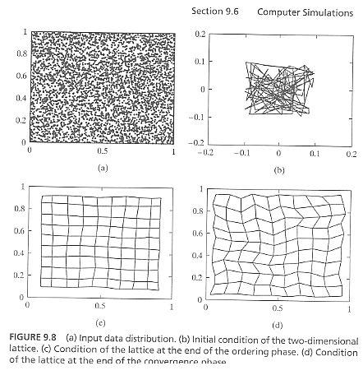
Example 1: results
Notes:
the weight vectors tend to follow the distribution of the examples.
最后网格的一个节点 代表输入空间中成堆（cluster) 的 一组 输入

Slide 35
Example 2
A one dimensional lattice driven by a two dimensional distribution:
100 neurons arranged in one dimensional lattice.
Input space is the same as in Example 1.
Weights are initialised with random values (again like in example 1).

Slide 36
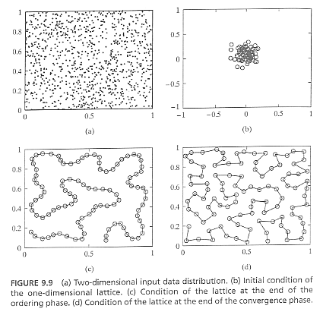
Example 2: results
Notes:
the weight vectors tend to follow the distribution of the examples.
与前面很相似，但每个neuron的邻居只于左右，而没有前后关系

Slide 37
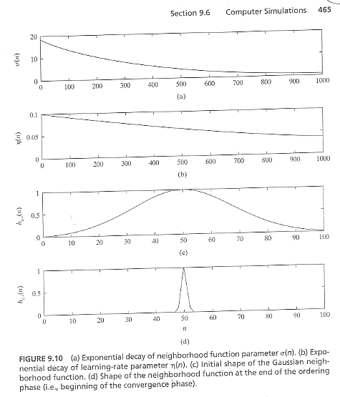
Example 2: parameter evolution
邻域参数指数衰减；学习率参数指数下降；高斯邻域函数变化过程

Slide 38
Properties of the Feature map/9.5
Approximation of the input space
The feature map, represented by the set of synaptic weight vectors in the output space, provides a good approximation to the input space.
Notes:
SOM is non-linear generalization of PCA

Slide 39
Properties of the Feature map/9.5
2. Topological Ordering
The feature map computed by the SOM algorithm is topologically ordered in the sense that the spatial location of a neuron in the lattice corresponds to a particular domain or feature of input patterns.

Slide 40
Properties of the Feature map/9.5
3. Density Matching
The feature map reflects variations in the statistics of the input distribution:
regions in the input space from which sample vectors are draw with a high probability of occurrence are
mapped onto larger domains of the output space, and therefore with better resolution than regions in input space from which sample vectors are drawn with a low probability of occurrence.

Slide 41
Properties of the Feature map/9.5
4. Feature selection
Given data from an input space with a nonlinear distribution, the self-organizing map is able to select a set of best features for approximating the underlying distribution.

Slide 42
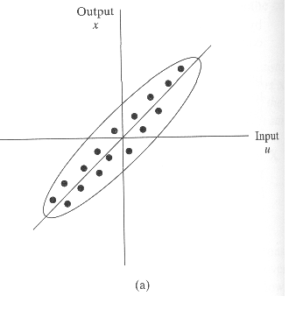
Properties of the Feature map/9.5
4. Feature selection
Figure 9.1a Two-dimensional distribution produced by a linear input-output mapping
A linear PCA may find the principal component- a “linear distribution”

Slide 43
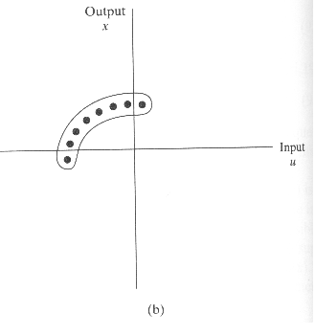
Properties of the Feature map/9.5
4. Feature selection
Fig.9.1(b) Two-dimensional distribution produced by a non-linear input-output mapping
SOM may find the “principal curves” or “principal surfaces”
Notes:
It is impossible for a straight-line approximation computed from principal components analysis to provide an acceptable description of the data.
On the other hand, the use of a SOM built on a one-dimensional lattice of neurons is able to overcome this approximation problem by virtue of its topological-ordering property.
In precise terms we may state the self-organized feature maps provide a discrete approximate of the so-called principal curves or principal surfaces, and may therefore be viewed as a non-linear generalization of principal components analysis.

Slide 44
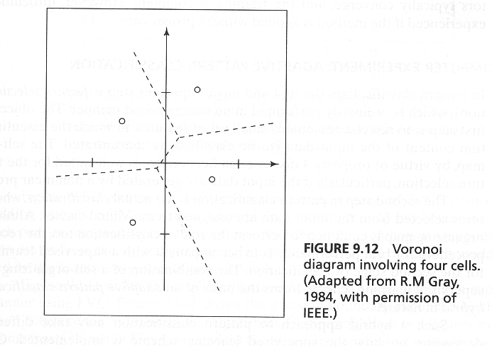
Learning Vector Quantisation /9.7
Vector quantisation is a technique designed for data compression.
A vector quantiser with minimum encoding distortion is a called a Voronoi or neares-neighbour quantizer.
Notes:
输入空间被分成一些不同的区域，并且对每一个区域定义一个重建向量。

Slide 45
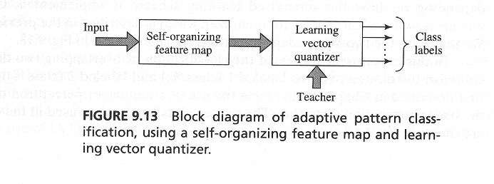
Learning Vector Quantisation
Learning Vector Quantisation (LVQ) is a supervised learning technique that move the Voronoi vectors slightly. So as to improve the quality of the classifier decision regions.
It can be devided into two parts: a competitive layer and a vector quantization layer:
Notes:
第2步学习矢量量化， 提供一个最后细调特征映射的机制。

Slide 46
Learning Vector Quantisation
1) The SOM algorithm provides an approximate method for computing the Voronoi vectors in an unsupervised manner ( the Property 1 discussed above)
2) The second stage is provided by learning vector quantization , which provides a mechanism for the final fine tuning of a feature map.

Slide 47
Learning Vector Quantisation
LVQ is a supervised learning that uses class information to move the Voronoi vectors slightly, so as to improve the quality of the classifier decision regions.
For a randomly picked vector x, if the class labels of x and a Voronoi vector w agree, move the vector w in the direction of the input vector x; otherwise, if they disagree, the vector w is moved away from the input vector x.

Slide 48
Learning Vector Quantisation (3)
The algorithm:
  Let {w_{j}}_{j=1}^{l} denote the Voronoi vectors and let {x_{i}}_{i=1}^{N} the input vectors.
  ξ_{wc} is the class associated with w_{c}. ξ _{xi} is the class associated with x_{i}.
    If ξ_{wc} = ξ _{xi} then:
      W_{c}(n+1) = w_{c}(n) + α_{n} [x_{i} - w_{c}(n)]
    If ξ _{xi} <> ξ _{xi} then:
      W_{c}(n+1) = w_{c}(n) - α_{n} [x_{i} - w_{c}(n)]
    The other Voronoi vectors are not modified.

Slide 49
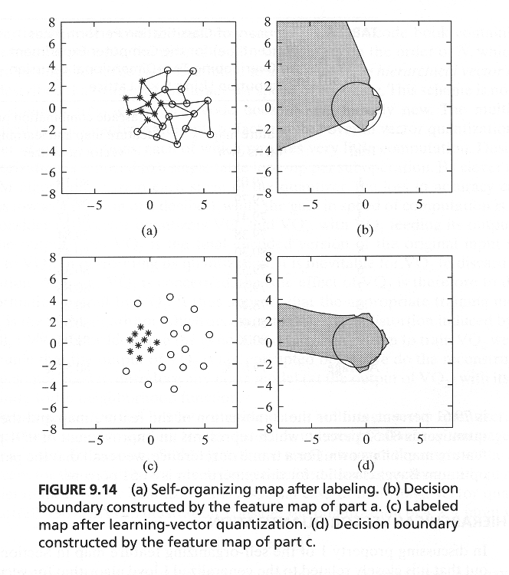
Learning Vector Quantization
Example/9.8:
Overlaping two-dimensional, Gaussian-distributed patterns
a-b) SOM only
c-d) SOM + LVQ
Table 9.2 / page 470
Notes:
仍然是以前那个 部分重叠的gaussian 分布的情况

Slide 50
9.10 Contextual Maps
The input vector
X=[Xs,Xa]^{T}, Xa(table 9.3) -- 13 elements; 9.3), Xs- 16 elements
Table 9.3: Animal 16
Attributes 13
Xs consists of a column vectors whose kth element, representing animal k=1,2,…,16, is given a fixed value of a; the remaining elements are all set equal to zero.
The parameter a determines the relative influence of the symbol code compared to the attribute code. To make sure that the attribute code is the dominant one, a is chosen equal to 0.2
Figure 9.17/ 9.18

Slide 51
9.10 Contextual Maps
Table 9.3: Animal 16
Attributes 13
The input vector
X=[Xs,Xa]^{T},
Xa(table 9.3) –a1-- 13 elements; 9.3),
Xs- 16 elements
a1=[1 0 0 1 0 0 0 0 1 0 0 1 0
1 0 0 1 0 0 0 0 1 0 0 0 0
1 0 0 1 0 0 0 0 1 0 0 0 1
1 0 0 1 0 0 0 0 1 0 0 1 1
1 0 0 1 0 0 0 0 1 1 0 1 0
1 0 0 1 0 0 0 0 1 1 0 1 0
0 1 0 1 0 0 0 0 1 1 0 1 0
0 1 0 0 1 1 0 0 0 1 0 0 0
0 1 0 0 1 1 0 0 0 0 1 0 0
0 1 0 0 1 1 0 1 0 1 1 0 0
1 0 0 0 1 1 0 0 0 1 0 0 0
0 0 1 0 1 1 0 0 0 1 1 0 0
0 0 1 0 1 1 0 0 0 1 1 0 0
0 0 1 0 1 1 1 1 0 0 1 0 0
0 0 1 0 1 1 1 1 0 0 1 0 0
0 0 1 0 1 1 1 0 0 0 0 0 0]
a2=eye(16);
a3=[a2 a1];
%size16*29
Notes:
其中a2 是动物的符号代码，由一列一列的数据构成，在每一列中，只有对应那个动物的位置为 a（取 0.2) , 其它为0

Slide 52
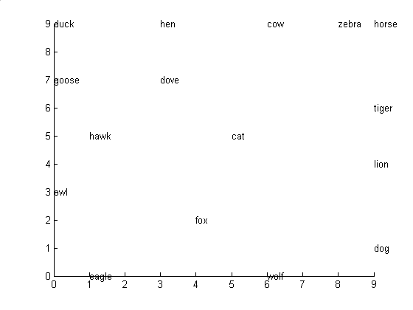
9.10 Contextual Maps
Fig.9.17 Feature map containing labeled
neurons with strongest responses to
their respective inputs

Slide 53
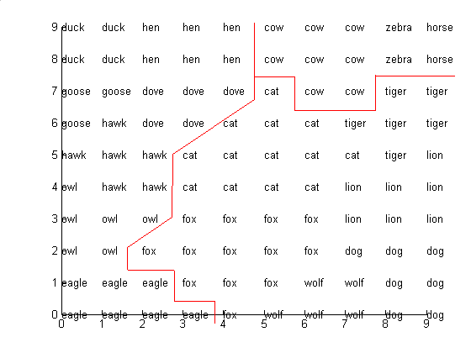
9.10 Contextual Maps
Fig.9.18 Semantic map. The map is devided
into three regions representating:
birds, peaceful species and hunters.

Slide 54
Data analysis with the SOM.
Self Organizing Map-based methods are developed for data analysis and information visualization. Applications of the SOM are studied in groups specializing on bioinformatics, learning metrics, speech, and natural language modelling.
The largest application of the SOM in data mining, WEBSOM, deals with the organization of large document collections.
SOM methods are also used in sleep disorder research, for which automated analysis methods are developed.
Notes:
Metrics 诗韵学

Slide 55
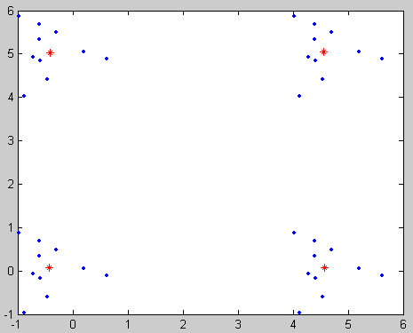
Example
p=rands(10,2);
p1=[p(:,1)+5 p(:,2)];
p2=[p(:,1) p(:,2)+5];
p3=[p(:,1)+5 p(:,2)+5];
Q=[p' p1' p2' p3' ]';
[W1s p1]=som_1d(Q,4,10, [.1 18]);
[W2s p2]=som_1d(Q,4,100, [p1(1) .001 p1(2) 0],W1s);
plot(Q(:,1)',Q(:,2)','.' )
hold
plot(W2s(:,1),W2s(:,2),'red*')
-------------
This program setup four group of points, and training SOM with four neurons resulted in the right map where the red “*” is the weight vector.

